Slide 1
Adaptive Artificial Intelligent
QA System
Group - 17-107

Slide 2
Introduction

Slide 3
A QA system for the growing information problem
High rate of information growth
QA system that can understand a given corpus.
Allow the user to ask questions in natural language form
Produce answers in natural language form
The high rate of growth of data means humans cannot keep up. A question answer system should be capable of operating in any domain.

Slide 4
Research Gap
Natural language question answering is not a new field. Research since the 1970’s have looked at NLP, Information Retrieval and Template based question answering.
We used Deep Learning techniques to address this problem.
The goal is to allow a person to interact with a knowledge base as naturally as possible via the question-answer format.

Slide 5
Corpus
Pre-Processing

Slide 6
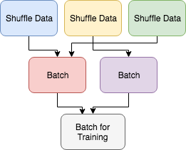
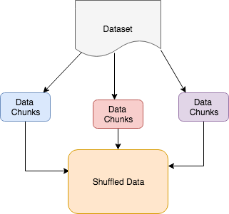
Corpus Preprocessing In a Nutshell
Automating the ‘pluggability’ of datasets into the system
Batching Process of the dataset
Shuffling Process of the dataset
Batching Process
Shuffling Process

Slide 7
Model Creation using LSTM

Slide 8
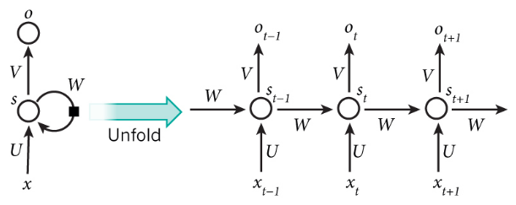
Why are we using a LSTM?
RNN is special kind of NN which can store previous data but it does not support long term dependencies.
The clouds are in the sky - Using RNN
I grew up in France… I speak fluent French. - RNN does not support this.
LSTM - are a special kind of RNN(4NN layers inside), capable of learning long-term dependencies and they work tremendously well on a large variety of problems, and are now widely used.
Reference - "Recurrent Neural Networks Tutorial, Part 1 – Introduction to RNNs", WildML, 2017. [Online]. Available: http://www.wildml.com/2015/09/ recurrent-neural-networks-tutorial-part-1-introduction-to-rnns/.
Notes:
"Recurrent Neural Networks Tutorial, Part 1 – Introduction to RNNs", WildML, 2017. [Online]. Available: http://www.wildml.com/2015/09/recurrent-neural-networks-tutorial-part-1-introduction-to-rnns/.

Slide 9
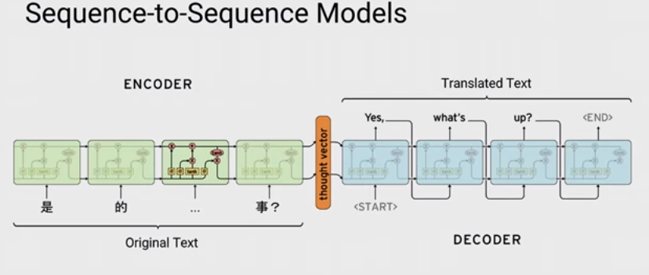
Sequence-to-Sequence Model
A basic sequence-to-sequence model, as introduced in Cho et al., 2014, consists of two recurrent neural networks (RNNs): an encoder that processes the input and a decoder that generates the output.
Notes:
As you can see this image contains the S2S model of Google translator. This is the same model we used in our project and it contains an encoder to receive a word or sequence of words and decoder to generate the output as a word or sequence of words.

Slide 10
Question Pre-Processing

Slide 11
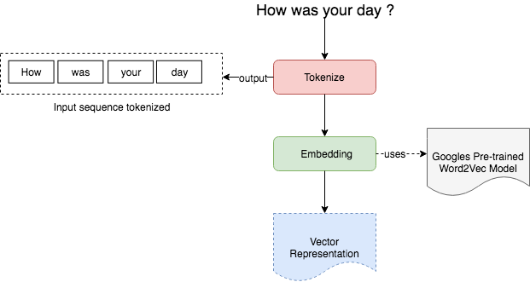
How does Pre-processing work ?

Slide 12
Answer Generation

Slide 13
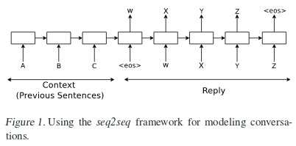
How are we getting answers?
Once the question has been processed, the neural network will map the answer using the sequence to sequence model.
We use a predictive RNN to predict what the next word of the answer sentence will be.
The input sequence is the conversation that has been carried out so far. The output from the model is the reply to the question.
Reference - Vinyals, O. and V. Le, Q. (2015). A Neural Conversational Model. Cornell University Library. [online] Available at: https://arxiv.org/abs/1506.05869
Notes:
Vinyals, O. and V. Le, Q. (2015). A Neural Conversational Model. Cornell University Library. [online] Available at: https://arxiv.org/abs/1506.05869

Slide 14
Demo

Slide 15
Performance

Slide 16
Dataset used
Cornell Movie Dialogues Corpus
220,579 conversational exchanges between 10,292 pairs of movie characters
9,035 characters from 617 movies
304,713 total utterances
Movie metadata including: genres, release year, IMDB rating, IMDB votes
Character metadata: gender, position on movie credits
A. Garg and V. Polamreddi, "Understanding Hollywood through Dialogues", Stanford, 2017.
Ubuntu Dialogue Corpus
930,000 dialogues
269 million words of text, spread out over 26 million turns
7,100,000 total utterances
Conversations have an average of 8 turns each, with a minimum of 3 turns
R. Lowe, N. Pow, I. Serban and J. Pineau, "The Ubuntu Dialogue Corpus: A Large Dataset for Research in Unstructured Multi-Turn Dialogue Systems", Cornell University Library, 2015.

Slide 17
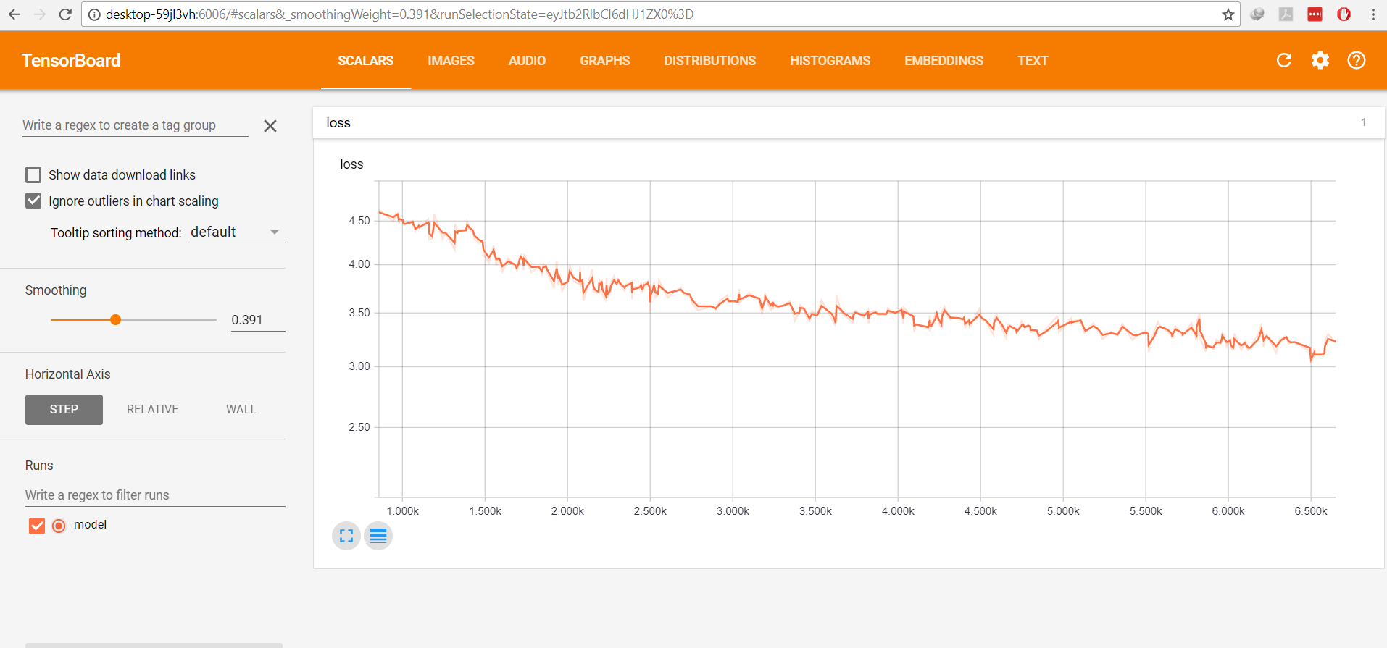
Performance benchmark and limitations
Perplexity at 30-35
Epochs - 30
Hours to train - 14 hours

Slide 18
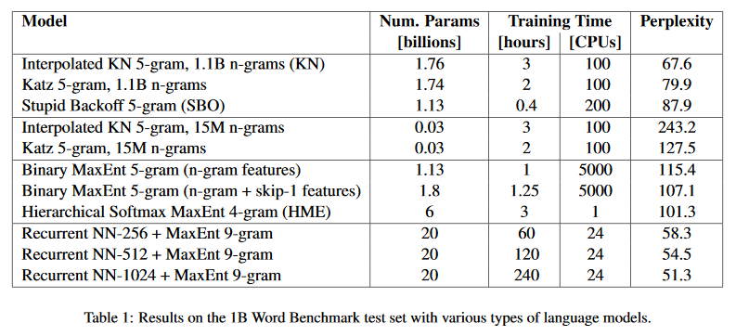
Industry benchmarks
[1]P. Koehn and T. Robinson, "One Billion Word Benchmark for Measuring Progress in Statistical Language Modeling", 2013.

Slide 19
Business Model

Slide 20
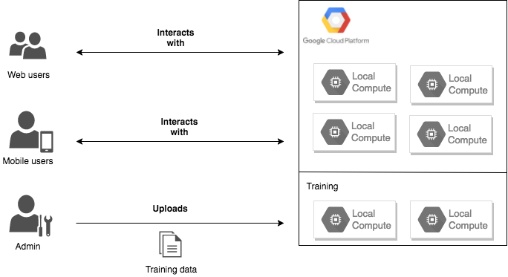
High level interaction
Cloud based architecture
Easy to use interfaces
Client has freedom to select how fast/efficient the training process is

Slide 21
Unique selling points
Focus on easy instance deployment by using containerization techniques (using Docker)
Interfaces decoupled from QA engine
Automating the ‘pluggability’ of datasets into the system by using automation scripts for formatting the dataset. Possibility of having an easy to use web interface for this task.
Identification of important aspects of target markets
Availability of data in text format
Data collected over at least 3 years
Heavy use of natural QA format, such as call center operations

Slide 22

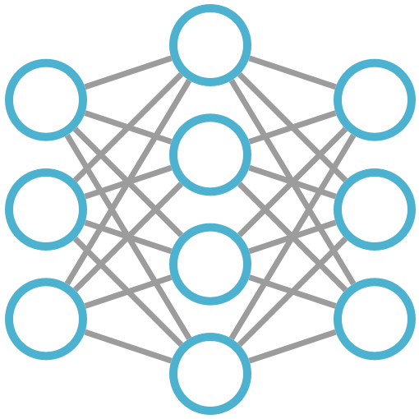
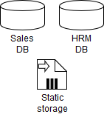


Customer Journey
Customer Acquisition
Implementation
Handover
Maintenance
Analyse the business and break down into multiple domains
Train different models for each of the domains
Implement the white labeled applications and customized UI’s as required
New data that is collected will be given and models will be re-trained from time to time
User provides the required data, in the format we request.
Using Agile methodologies, the customer is always kept in the loop for testing
Conduct the User Acceptance Testing and put into place the new processes
Continuously collect data in the given domains and document evolving use cases
Deliverables

Slide 23
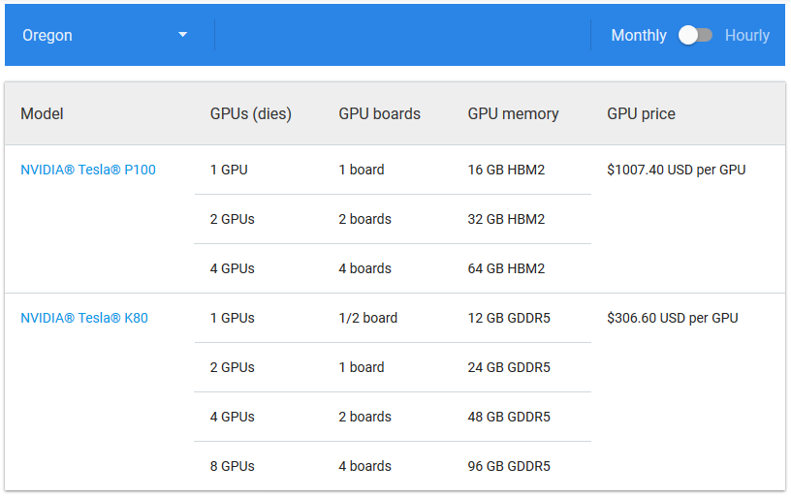
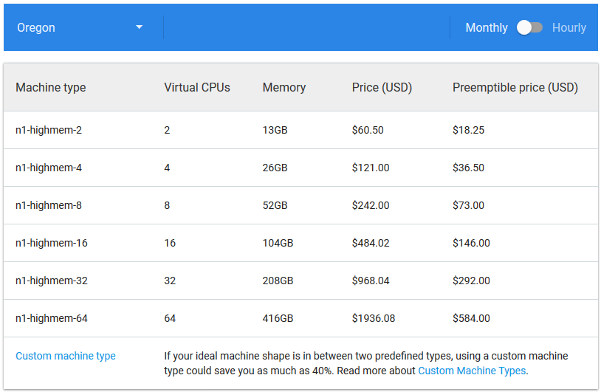
Pricing model
Scalable training based on Google Cloud Platform pricing

Slide 24
Challenges

Slide 25
Challenges faced
Availability of usable datasets was a big problem. Most datasets contain private information and therefore requires more bargaining power/legitimacy to obtain.
Training models on GPU enabled instances is expensive. One estimate came up to around $4000 a month!
From other researchers we found that at least 1000 epochs were required to get a reasonable accuracy. 30 epochs take 12 hours approximately.

Slide 26
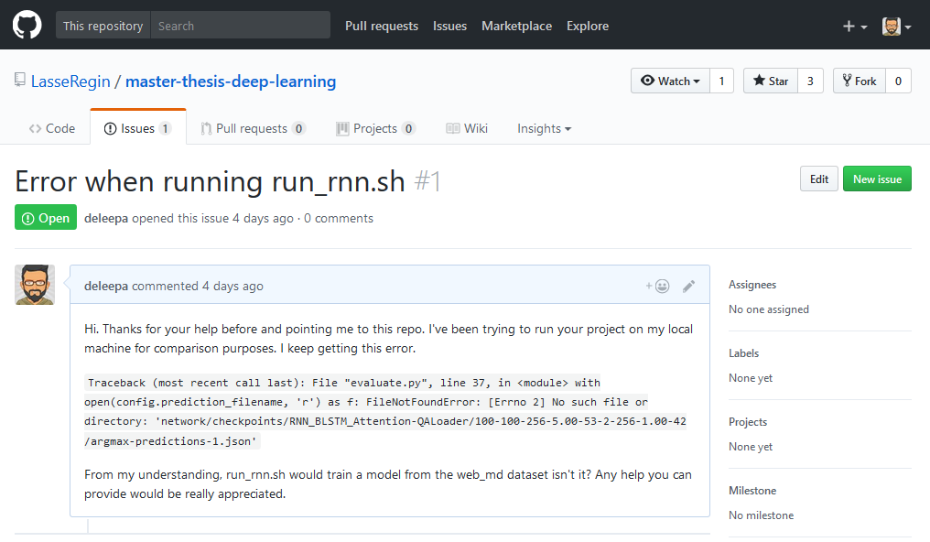
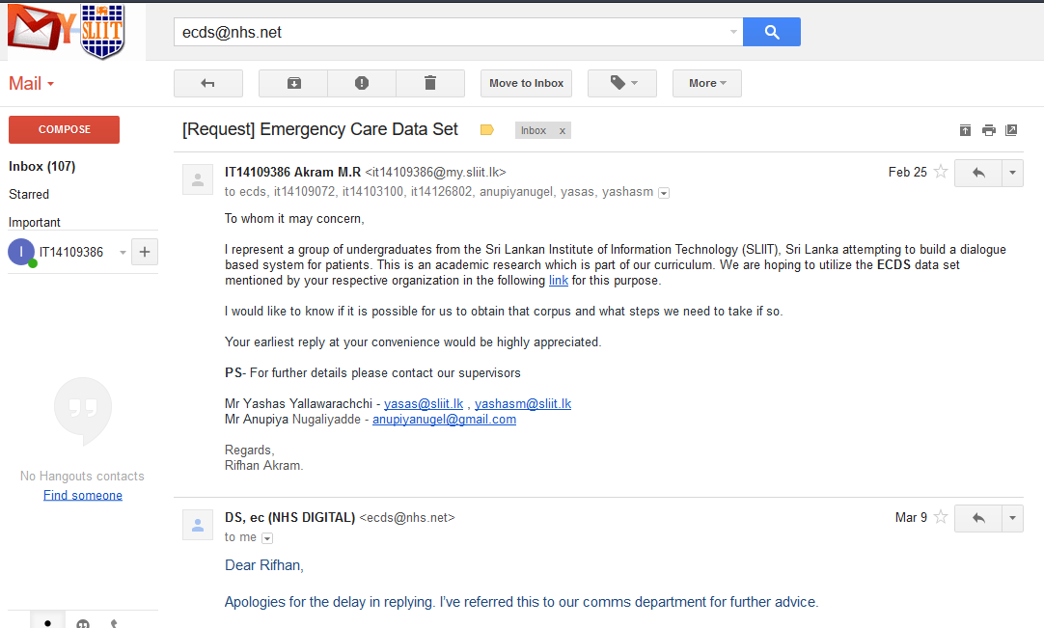
Community support
Working with the deep learning community was challenging sometimes because they did not recognise our work sometimes.

Slide 27
Appendix

Slide 28
TensorBoard
Notes:
To make it easier to understand, debug, and optimize TensorFlow programs, The lower the Loss, the better a model (unless the model has over-fitted to the training data). The loss is calculated on training and validation and its interperation is how well the model is doing for these two sets. Loss is not in percentage as opposed to accuracy and it is a summation of the errors made for each example in training or validation sets

Slide 29
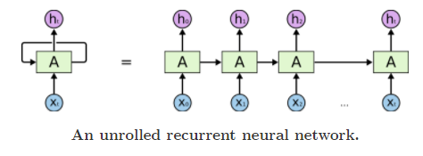
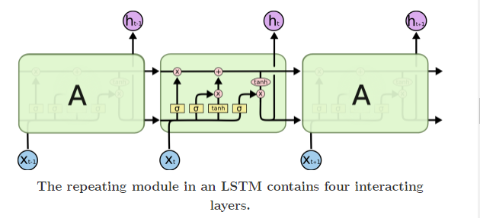
Why LSTM?
“the clouds are in the sky” vs “I grew up in France… I speak fluent French.”
LSTMs are a special kind of RNN, capable of learning long-term dependencies
Notes:
We need our network to remember the past in order to answer the questions, but default RNNs can't handle this issue in the practical environment. LSTM is a special type of network built to support this problem. It has cell based structure with 4 NN layer in each which have ability to add or remove information.

Slide 30
Why Shuffling? Why Batching?

Slide 31
How?
Current dataset are of Q&A pairs.
Following steps needs to be done for the dataset.
Shuffle
Batch

Slide 32
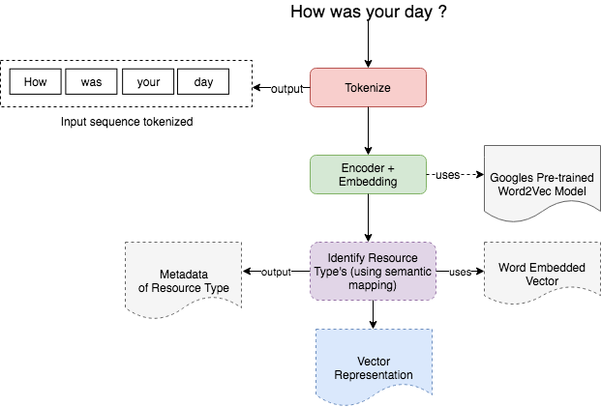
Improvements

Slide 33
Improvements
Poor performance in answer text generation because of the token based predictive model. A character based model would be better.
The current RNN is trained on a QA dataset. Not a long running conversational dataset. Attempt to train on a better dataset to see improvements.
Notes:
"Recurrent Neural Networks Tutorial, Part 1 – Introduction to RNNs", WildML, 2017. [Online]. Available: http://www.wildml.com/2015/09/recurrent-neural-networks-tutorial-part-1-introduction-to-rnns/.

Slide 34
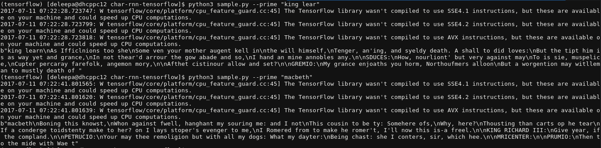
Improvements
Sample output from 128-cell, 2-layer RNN.
Notes:
"Recurrent Neural Networks Tutorial, Part 1 – Introduction to RNNs", WildML, 2017. [Online]. Available: http://www.wildml.com/2015/09/recurrent-neural-networks-tutorial-part-1-introduction-to-rnns/.

Slide 36
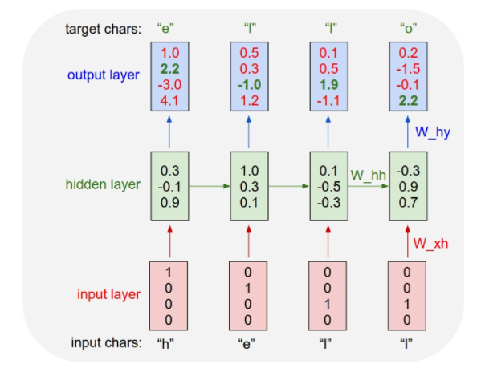
Char-RNN
The following diagram depicts a RNN that is being trained on a language model of four letters (‘E’, ‘H’, ‘L’, ‘O’) to generate the word ‘hello’
This can be extended to a vocabulary of entire words.

